Slide 1
Form and Postal Utilities Cost Recovery Connector
Information Technology Solutions
An add-on for MailOne

Slide 2
Information Technology Solutions
Form and Postal Utilities Cost Recovery Connector for
MailOne™ software automates the recovery of office
mailing expenses by automatically synchronizing account
and postage data between the FP postage meter
MailOne software and a firms cost recovery system.

Slide 3
Information Technology Solutions
The Importance of Importing
Automatically import new client matter numbers and descriptions into FP MailOne accounts. The CRC Program reads in all the customers matters and converts it to MailOne format. It also deletes deactivated accounts before it imports new ones.

Slide 4
Importing Client Matters into Mailone Accounts
Information Technology Solutions
Automatically imports firms client/matter file.
Deletes inactive accounts from Mailone.
Imports new accounts into Mailone.
Start from a desktop icon.
Can be set to run as a scheduled task.

Slide 5
Information Technology Solutions
Import Accounts Flow
If not a scheduled task it prompts user to continue
CRC program sets focus to MailOne
Syncronizes current MailOne accounts
Syncronizes new client matter file
Compares client matter list to account list
Deletes deactivated accounts from MailOne
Imports new accounts into MailOne
Quit CRC Program
Import client matters into MailOne accounts

Slide 6
Importing in Action
Information Technology Solutions

Slide 7
Exporting Excellence
Information Technology Solutions
Automatically export meter postage from MailOne and imports it into a cost recovery or accounting system. User can manually export by date range or the CRC program can continuously append the new postage data to an export file or database. Includes checks to prevent duplicate postage exports and can apply chargeback in numerous ways.

Slide 8
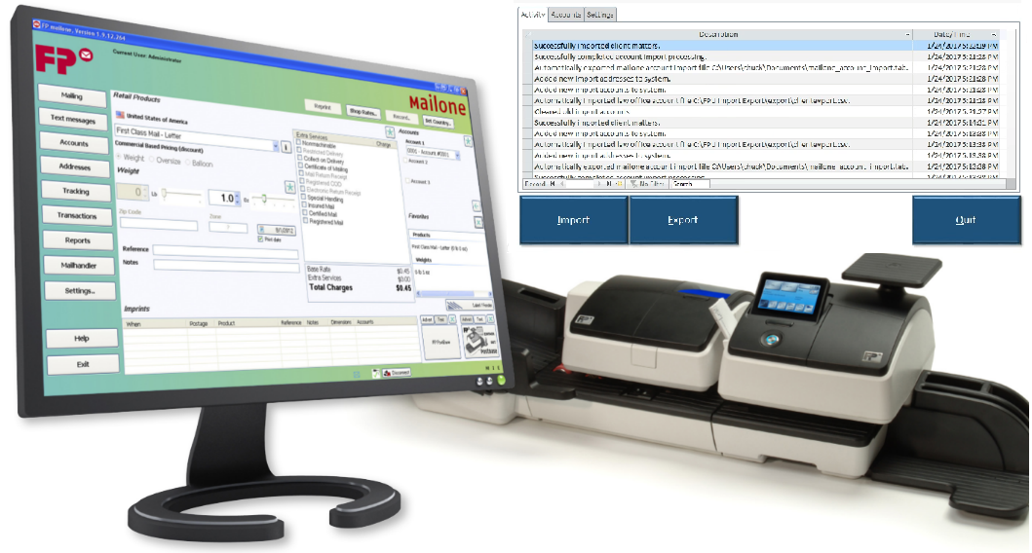
Exporting Postage File
Information Technology Solutions
Generates a formatted file for your cost recovery system
Export by date range.
Continuously append by using last export date/time.
Start from a desktop icon.
Can be set to run as a scheduled task.

Slide 9
Information Technology Solutions
Export Postage Flow
Export Postage Data out of MailOne for Import to Cost Recovery System
If not a scheduled task user is prompted to continue
CRC program sets focus to MailOne
CRC exports raw transaction data from MailOne
CRC imports raw postage file for processing
CRC filters data to all transactions by either date/time or start/end
Export File in customer compatible formate to specified Path
Quit CRC Program
User selects desired date range

Slide 10
The Ease of Exporting

Slide 11
Form and Postal Utilities Cost Recovery Connector
Information Technology Solutions
An add-on for MailOne
FP postage meter, MailOne and the Cost Recovery Connector. A single end to end postage processing cost recovery solution.

